Slide 1

Adaptive Data-Driven Audio Network for Speech Deepfake Detection
Dr. Poline, XIAN Yin
Department of Computer Science,
Hong Kong Baptist University (HKBU)
(polinexian@hkbu.edu.hk)

Slide 2

Outline
Introduction
Methods
Results
Summary

Slide 3
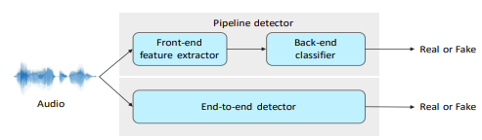
Audio deepfake detection
Goal:
Combat misinformation and fraud
Protect the automated speaker verification system
Potential applications:
Cybersecurity and fraud prevention
Digital forensics
Secure authentication (Biometrics)
Figure: Audio deepfake detection structure [1]

Slide 4
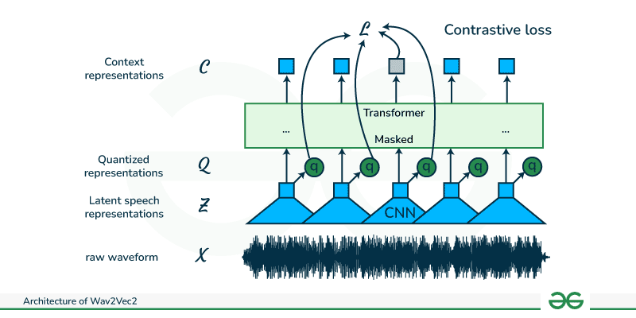
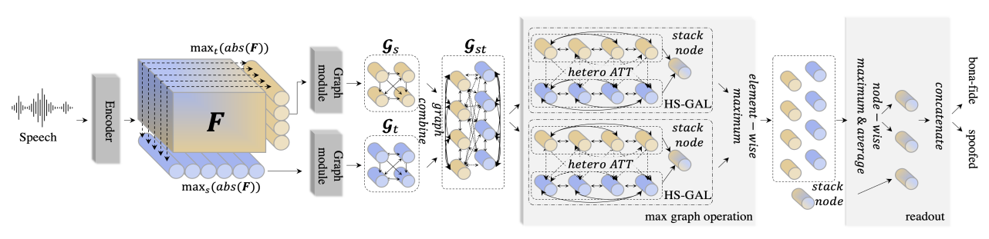
Current Audio Deepfake Detection Models
AASIST/ AASIST 3 ( and variants)
1D raw audio data as input
SincConv and residual blocks in the models.
Similar to RawNet2 structure.
Graph-based attention network
Combined with SSL frontends
Wav2Vec2, XLS-R, or HuBERT
Raw waveform as input
Multiple layers of CNN to generate features
Latent representations are fed into a transformer network
Figure: Wav2Vec2 structure [3]
Figure: AASIST structure [2]

Slide 5
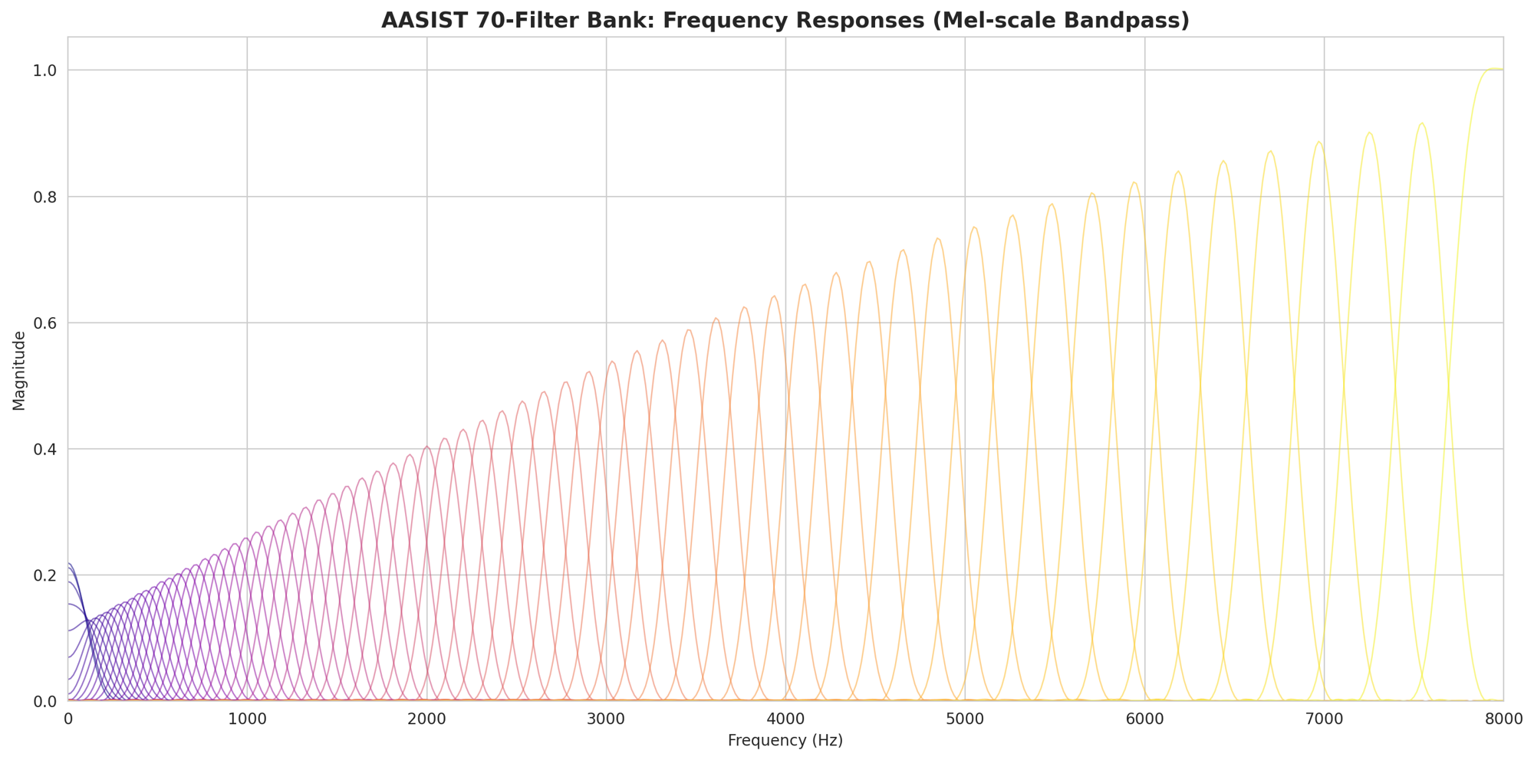
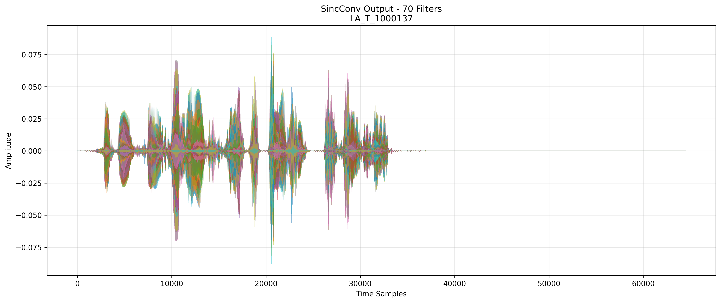
SincConv Layer in AASIST
SincConv: 1D convolutions with band-pass filters
Risk of overfitting to frequency bands
Parameter reduced for convolution filter coefficients, but higher on kernel generation (5-10%) FLOPs contribution
Figure: AASIST structure [2]

Slide 6
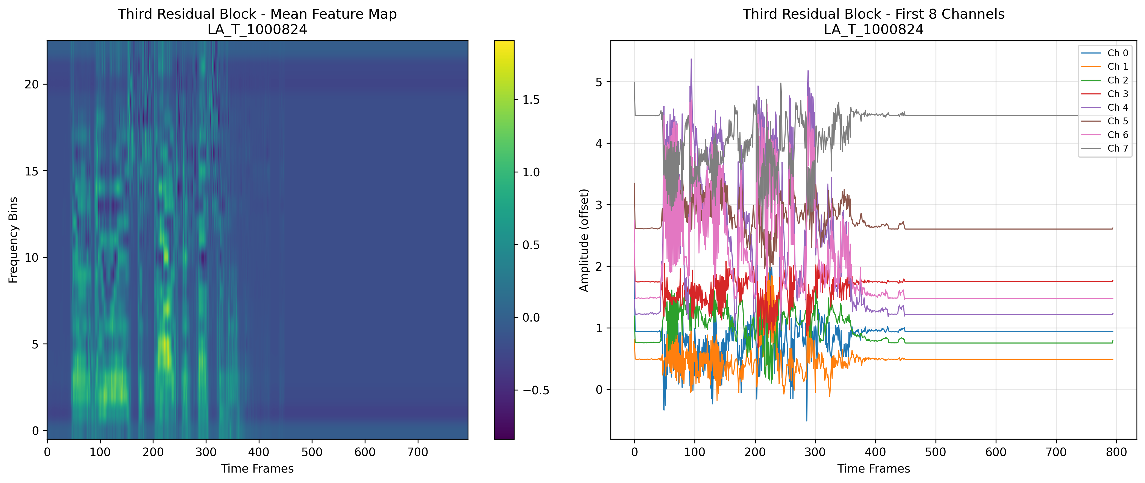
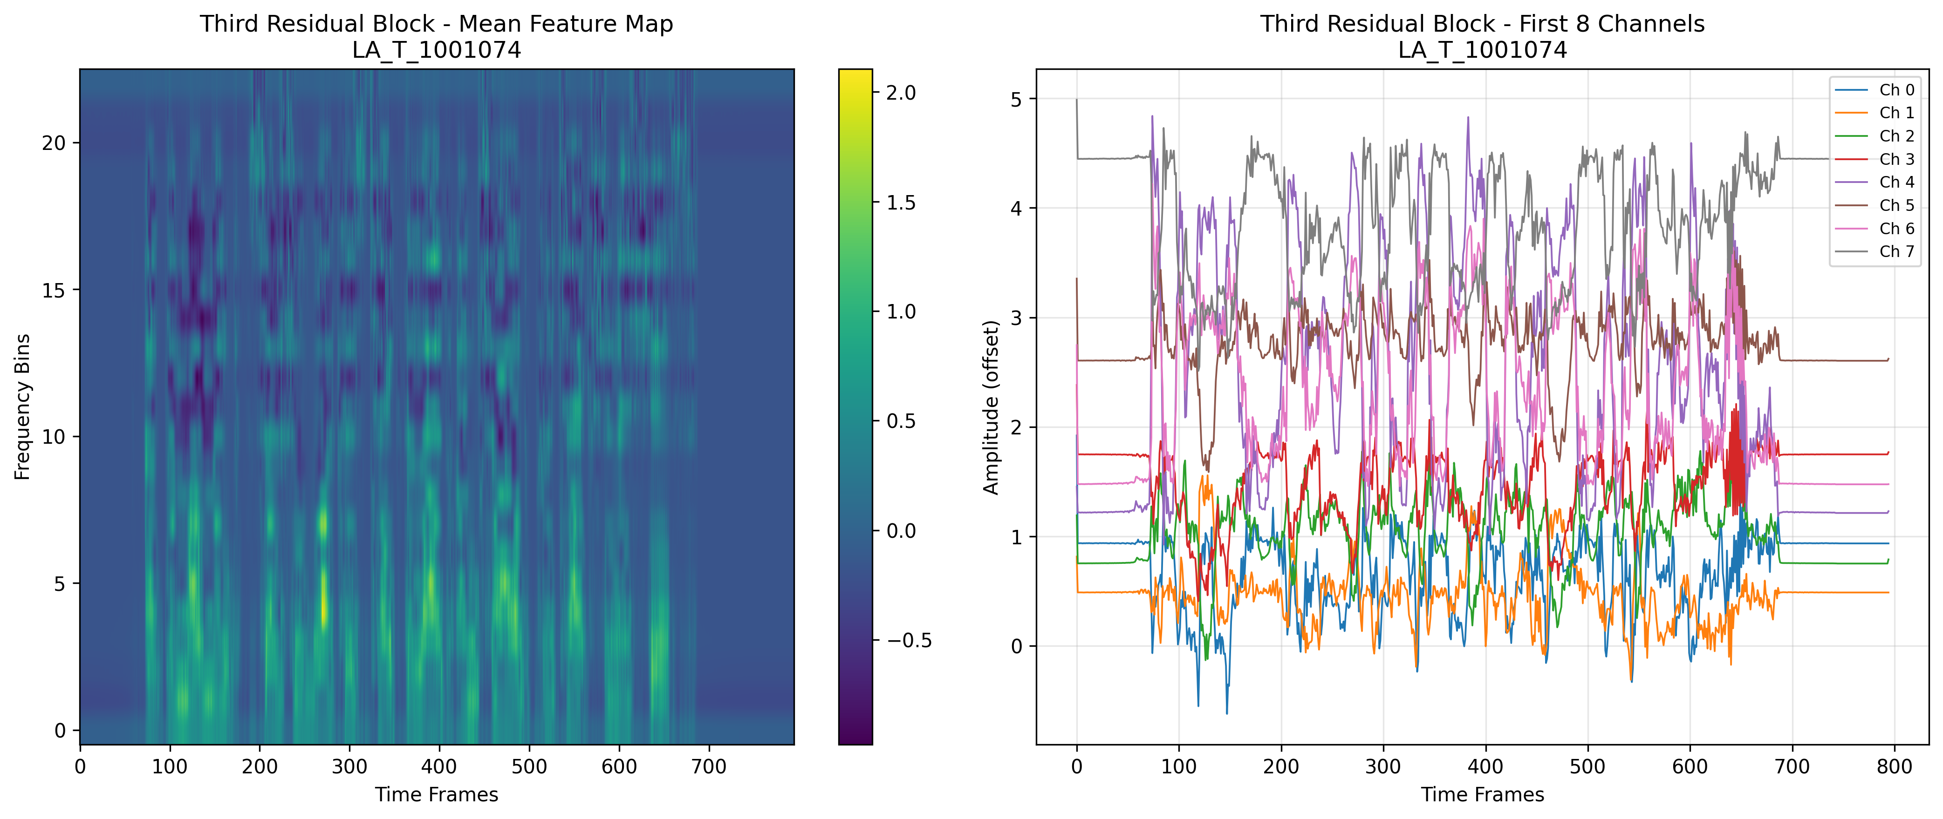
Residual Blocks in AASIST
SincConv: 1D convolutions with band-pass filters
Risk of overfitting to frequency bands
Parameter reduced for convolution filter coefficients, but higher on kernel generation (5-10%) FLOPs contribution
Residual block as encoder is computationally heavy
About 70% FLOPs contribution
Far lighter than WavLM, XLS-R in memory
Figure: AASIST structure [2]

Slide 7
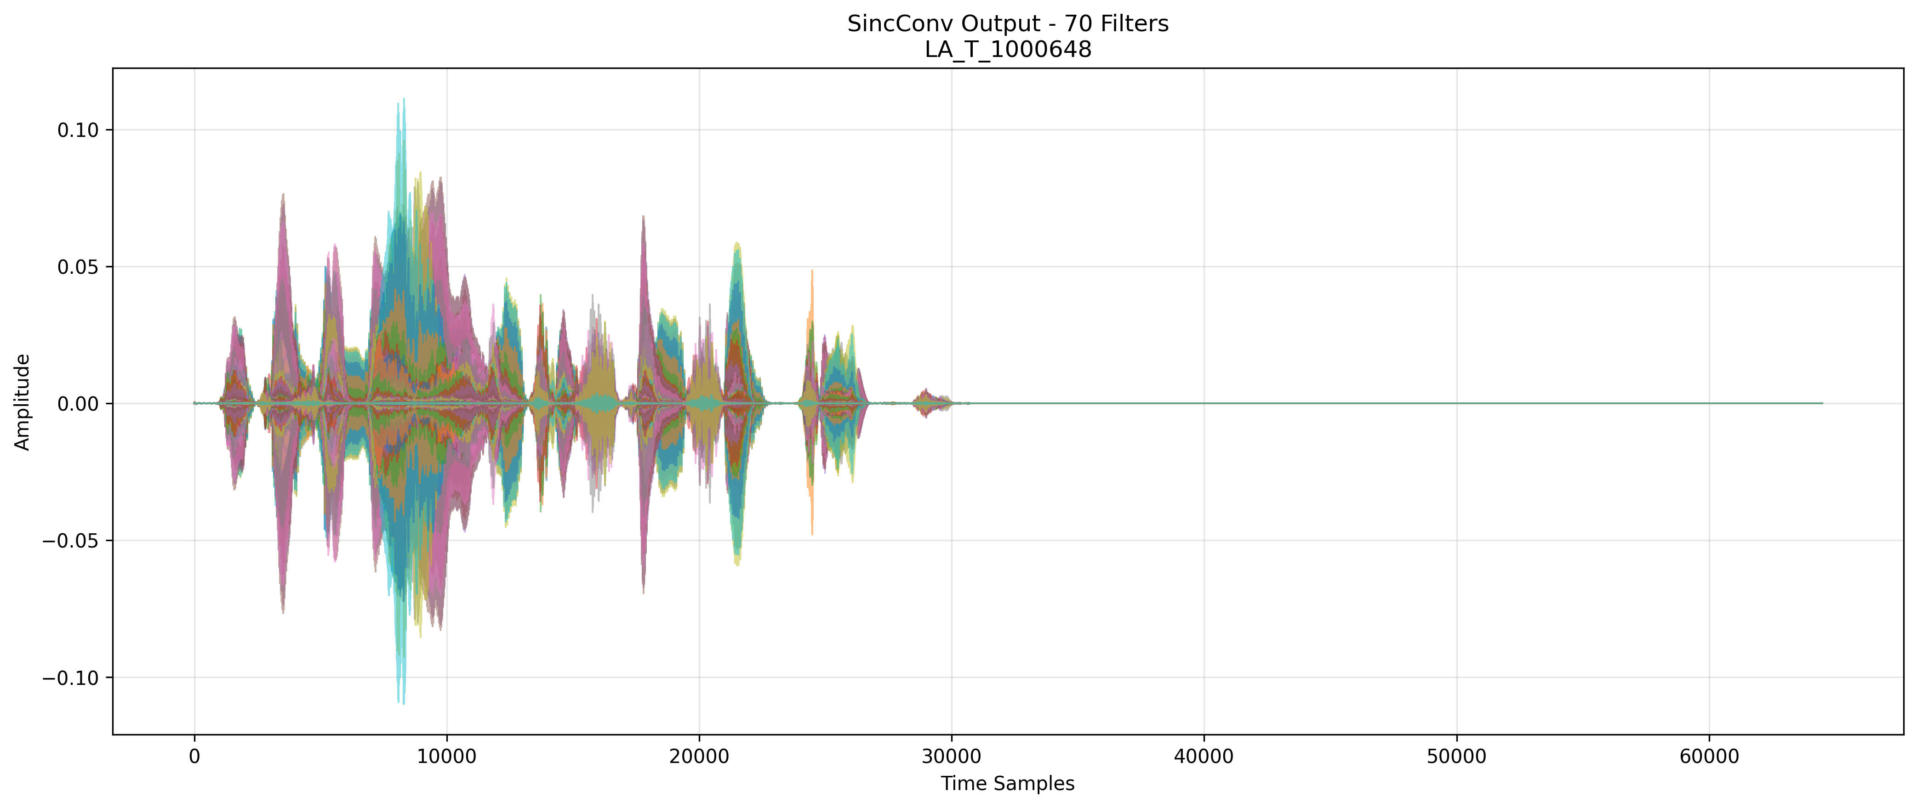
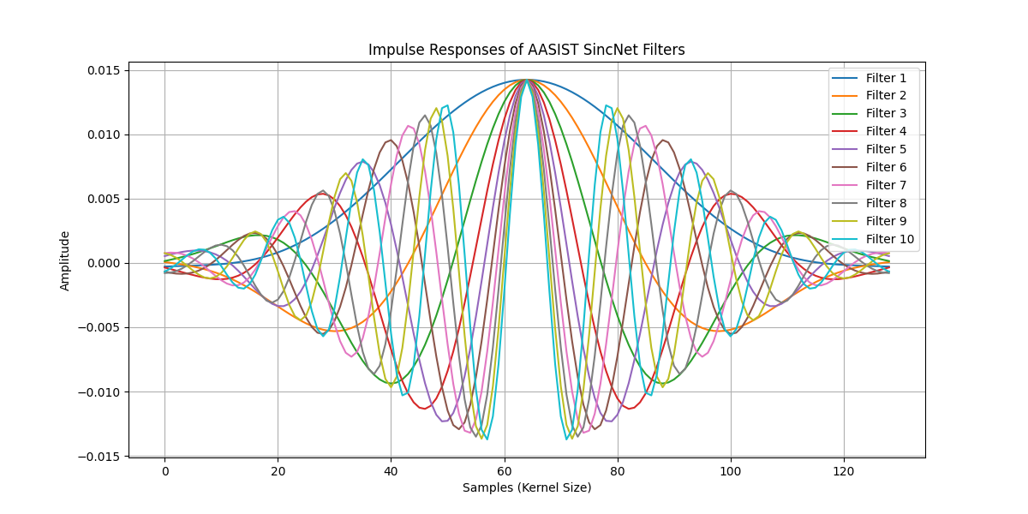
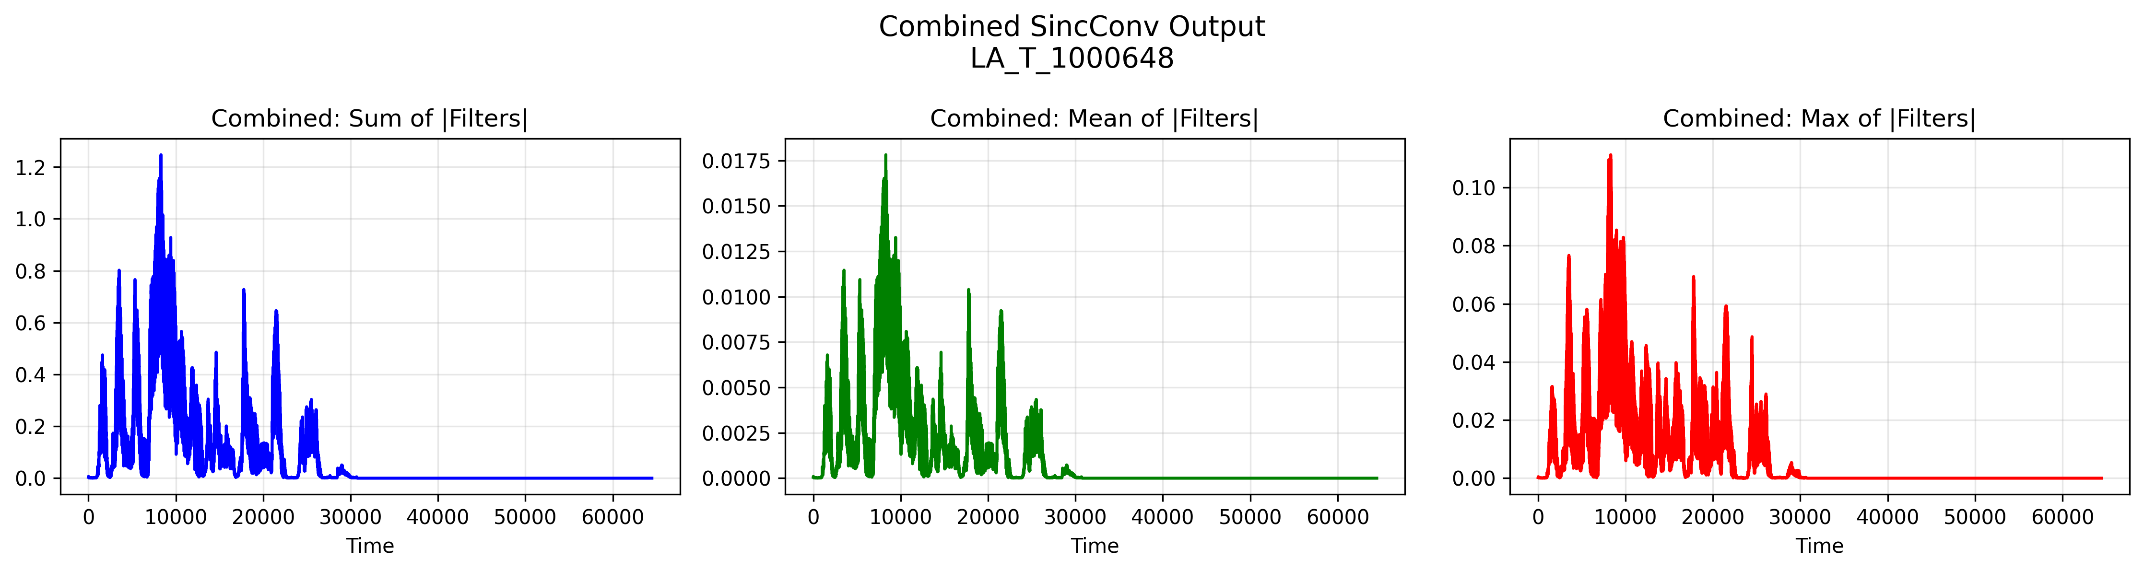
SincConv filters
Impulse response of SincConv filters
LA_1000648 output waveform
SincConv filters
Applied in the time domain to preserve the phase information.
Stride=1, preserves maximum temporal resolution (compared with stride=4-8 in wav2vec2 CNN)
Detect synthetic artifacts at fine time scales
Downsample in residual blocks

Slide 8
Experimental Results
Datasets
English: ASVspoof 2019 LA dataset [4]
107 speakers. 10000 true speech data, and 10000 fake data using 19 methods.
Mandarin: CFAD dataset (Chinese dataset for fake audio detection). R01-R04 real audio data and the clean fake dataset for testing [5]
Use true speech data from 3 source, 6 types of fake data with different AI methods.
Cantonese: the fake data are generated with methods: AR, Minimax, Cantonese AI, Vits2, HifiGAN, and Bvs2; the real data obtained from Tan Lee’s team at CUHK.
10,000 data samples, true data 5000 samples, and AI generated data 5000 samples using 6 methods.
Fake audio data examples: AR, BVS2, CantoneseAI, HifiGAN, Minimax, and VITS2; true speech data example.

Slide 9
Experimental Results
Evaluation:
Classification accuracy
Clustering results

Slide 10
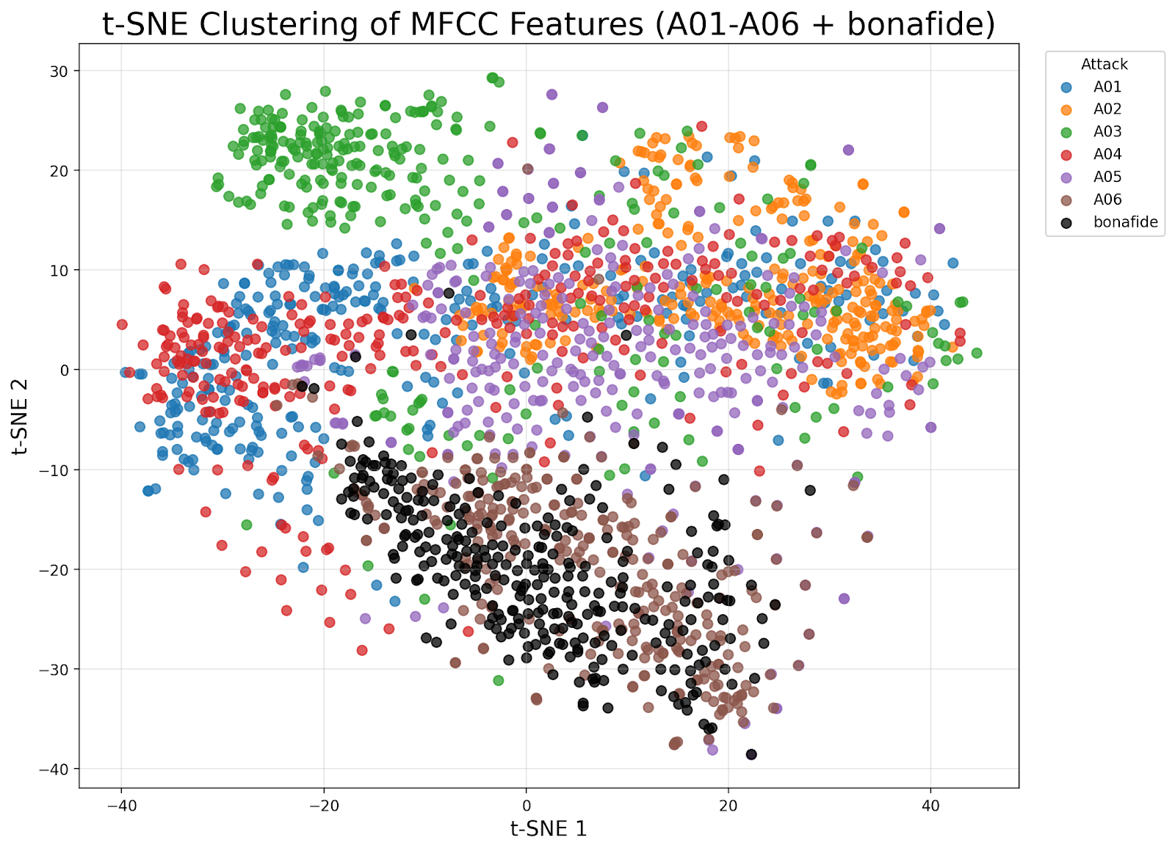
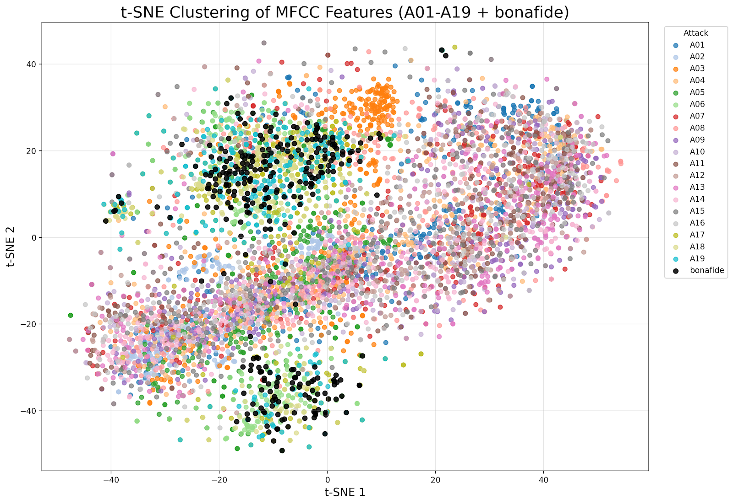
ASVspoof 2019 Experiment
Clustering with T-SNE after PCA projection into 100 dimensions of real and fake data (6 classes)
Clustering with T-SNE after PCA projection into 100 dimensions of real and fake data (19 classes)
Results
Sampling frequency: 16k, truncated into 3.5 seconds for preprocessing.
Training 80% of all data, validate 20%. 5-fold cross validation.
Classification accuracy calculation, with 90% to distinguish real and fake audio; and 85% to distinguish different fake audio generation methods.
Baseline: CQCC+GMM accuracy 76.17%

Slide 11
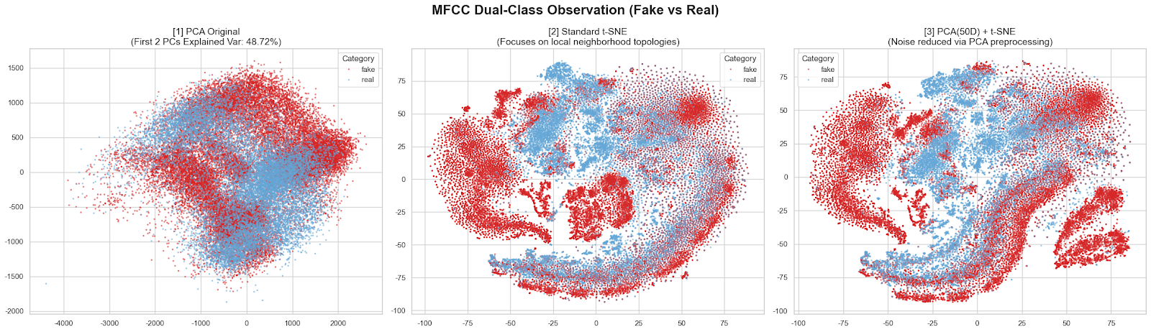
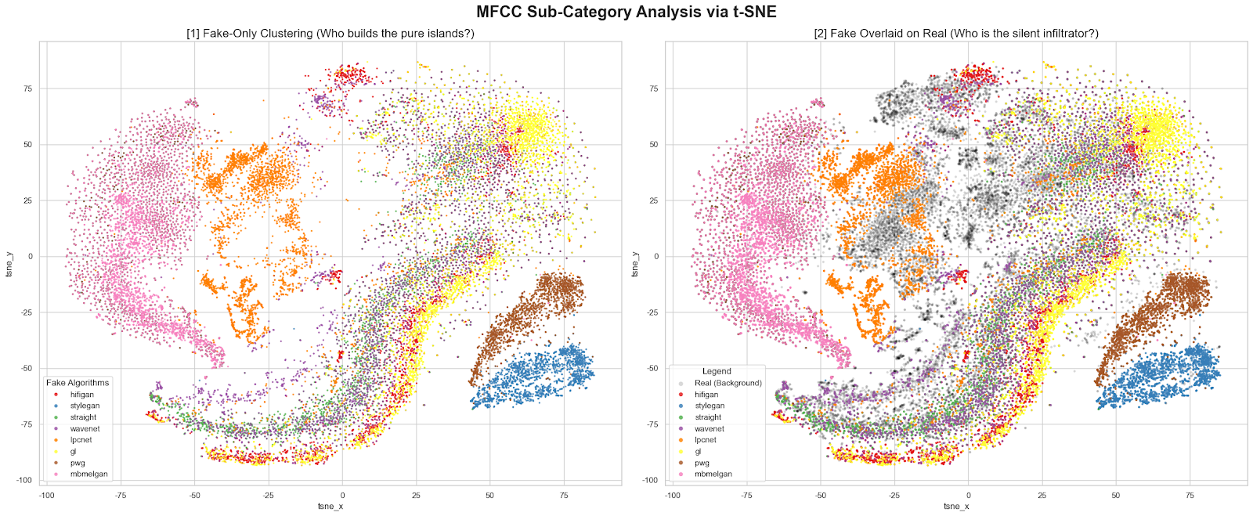
CFAD Experiment (Mandarin)
Clustering with T-SNE after PCA projection into 50 dimensions of real and fake data
Clustering with T-SNE after PCA projection of fake data using different methods
Results
Sampling frequency 22k, truncated into 3.5 seconds in length in preprocessing.
Training 80% of all data, validate 20%. 5-fold cross validation.
Classification accuracy calculation, with 95% to distinguish real and fake audio; and 92% to distinguish different fake audio generation methods.
Baseline: LFCC+LCNN accuracy 76.1%.

Slide 12
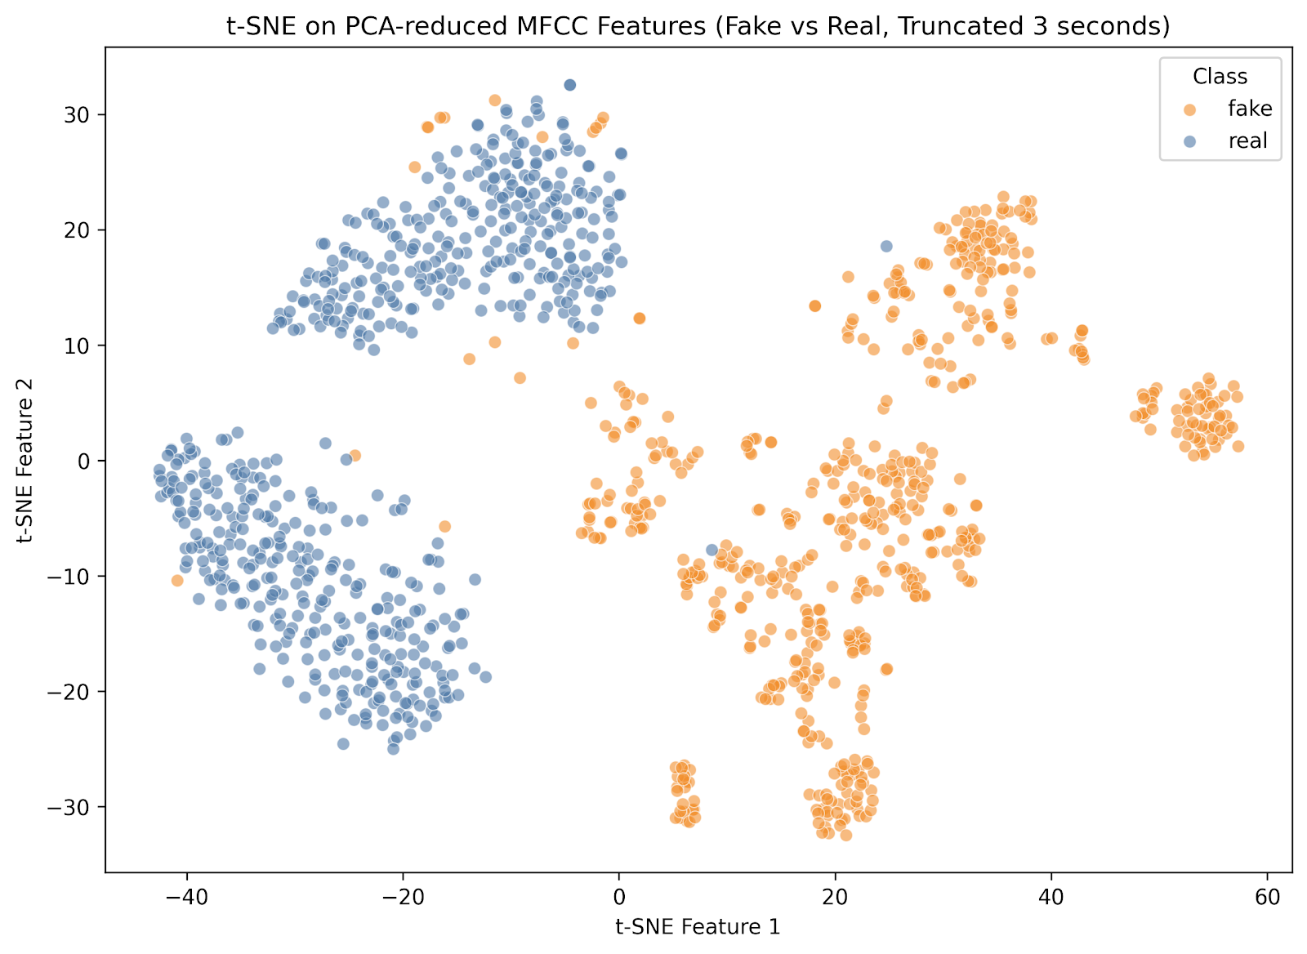
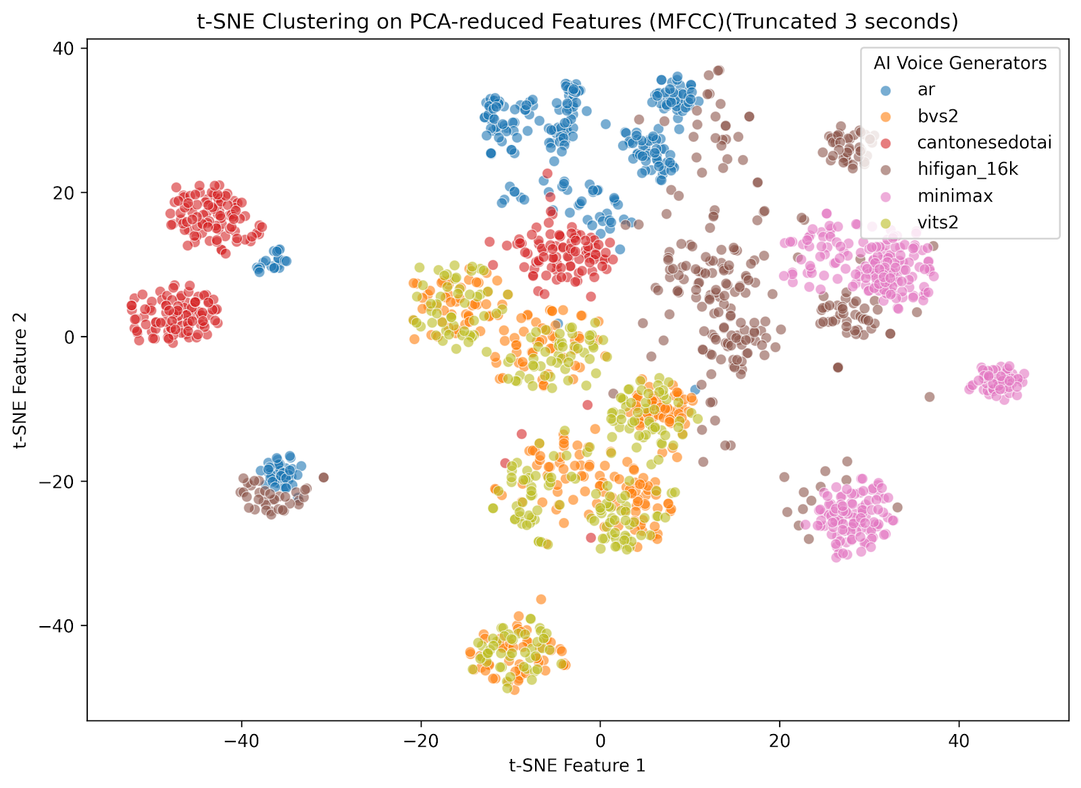
Experiment with Cantonese speech
Clustering with T-SNE after PCA projection of fake data using different methods
Clustering with T-SNE after PCA projection into 100 dimensions of real and fake data
Results:
Cantonese Speech dataset
Truncate them in 3 seconds for preprocessing, sampling frequency 22k.
6 AI methods to generate fake data, each has 300 samples.
Training 80% of all data, validate 20%. 5-fold cross validation.
Classification accuracy calculation, with 99% to distinguish real and fake audio; and 83% to distinguish different fake audio generation methods.

Slide 13
Major Reference
[1] Yi, J., Wang, C., Tao, J., Zhang, X., Zhang, C. Y., & Zhao, Y. (2023). Audio deepfake detection: A survey. arXiv preprint arXiv:2308.14970.
[2] Jung, J. W., Heo, H. S., Tak, H., Shim, H. J., Chung, J. S., Lee, B. J., ... & Evans, N. (2022, May). AASIST: Audio anti-spoofing using integrated spectro-temporal graph attention networks. In ICASSP 2022-2022 IEEE international conference on acoustics, speech and signal processing (ICASSP) (pp. 6367-6371). IEEE.
[3] Liu, A. H., Hsu, W. N., Auli, M., & Baevski, A. (2023, January). Towards end-to-end unsupervised speech recognition. In 2022 IEEE Spoken Language Technology Workshop (SLT) (pp. 221-228). IEEE.
[4] Nautsch, A., Wang, X., Evans, N., Kinnunen, T. H., Vestman, V., Todisco, M., ... & Lee, K. A. (2021). ASVspoof 2019: Spoofing countermeasures for the detection of synthesized, converted and replayed speech. IEEE Transactions on Biometrics, Behavior, and Identity Science, 3(2), 252-265.
[5] Ma, H., Yi, J., Wang, C., Yan, X., Tao, J., Wang, T., ... & Fu, R. (2024). CFAD: A Chinese dataset for fake audio detection. Speech Communication, 164, 103122.
[6] Xian, Y., Pu, Y., Gan, Z., Lu, L., & Thompson, A. (2017, March). Adaptive DCTNet for audio signal classification. In 2017 IEEE International Conference on Acoustics, Speech and Signal Processing (ICASSP) (pp. 3999-4003). IEEE.
[7] Cai, J. F., Ji, H., Shen, Z., & Ye, G. B. (2014). Data-driven tight frame construction and image denoising. Applied and Computational Harmonic Analysis, 37(1), 89-105.
[8] Xian, Y., Gu, H., Wang, W., Huang, X., Yao, Y., Wang, Y., & Cai, J. F. (2018, November). Data-driven tight frame for cryo-em image denoising and conformational classification. In 2018 IEEE Global Conference on Signal and Information Processing (GlobalSIP) (pp. 544-548). IEEE.

Slide 14

THANK YOU
Dr. Poline, XIAN Yin
polinexian@hkbu.edu.hk

Slide 15
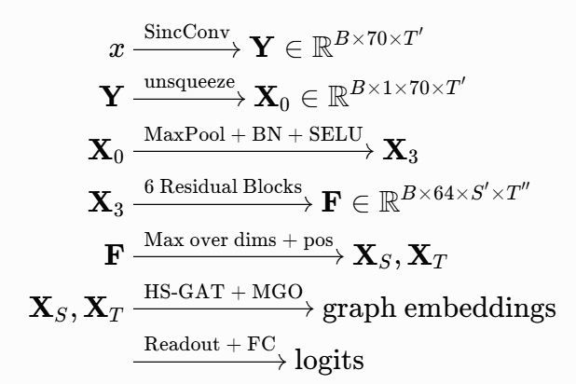
Overall pipeline of AASIST

Slide 16
Overall pipeline of AASIST

